Slide 1

SQL FINAL PROJECT IPL AUCITON strategy
-Aarohi Kapil
(1st June)

Slide 2

description
We have two tables:
IPL BALL(id, inning, over, ball, batsman, non_striker, bowler, batsman_runs, extra_runs, total_runs, is_wicket, dismissal_kind, player_dismissed, fielder, extras_type, batting_team, bowling_team)
IPL MATCH(id, city, date, player_of_match, venue, neutral_venue, team1, team2, toss_winner, toss_decision, winner, result, result_margin, eliminator, method, umpire1, umpire2)
We will shortlist top batsmen, bowlers and all-rounders based on their previous records and performances respectively.

Slide 3
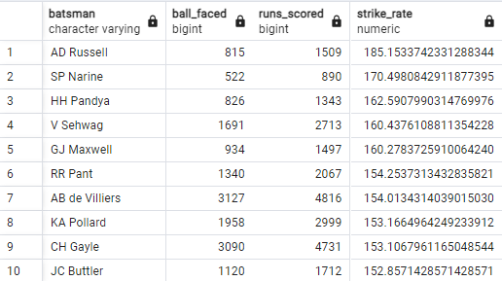
Bidding on batters
Batsmen who have high strike rates and have faced more than 500 balls in matches
SELECT batsman, COUNT(ball) AS ball_faced, sum(batsman_runs) AS runs_scored, sum(batsman_runs*100.0)/count(batsman_runs) AS strike_rate FROM IPL_Ball WHERE ball IN(SELECT ball WHERE extras_type = 'NA') GROUP BY batsman HAVING COUNT(ball)>=500 ORDER BY strike_rate DESC LIMIT 10;

Slide 4
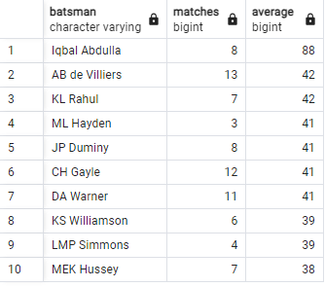
Bidding on batters
SELECT ib.batsman, COUNT(DISTINCT(EXTRACT(YEAR FROM im.date))) AS matches, sum(batsman_runs)/sum(is_wicket) AS average FROM IPL_Ball AS ib JOIN IPL_Match AS im ON ib.id = im.id GROUP BY ib.batsman HAVING COUNT(DISTINCT(EXTRACT(YEAR FROM im.date)))>2 ORDER BY average DESC LIMIT 10;
Batsmen with good average who have played more than 2 IPL seasons

Slide 5

Bidding on batters
Hard hitter players who have hit most of their runs in boundaries and have played at least 2 IPL seasons

Slide 6
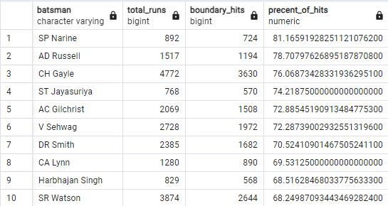
Query:
CREATE TABLE Boundaries ASSELECT batsman, SUM(batsman_runs) AS total_runs, SUM(CASE WHEN batsman_runs IN(4,6) THEN batsman_runs ELSE NULL END) AS boundary_hitsFROM IPL_BallGROUP BY batsman;
SELECT *, (boundary_hits*1./total_runs)*100 AS precent_of_hitsFROM Boundaries WHERE batsman IN(SELECT batsman FROM IPL_Ball GROUP BY batsman HAVING COUNT(DISTINCT id)>28 )ORDER BY (boundary_hits*1./total_runs)*100 DESC LIMIT 10;

Slide 7
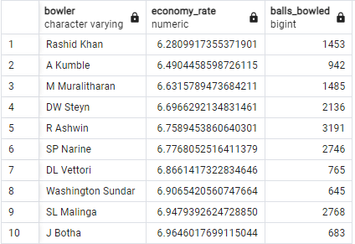

Bidding on bOWLERS
SELECT bowler, SUM(total_runs)*1./(COUNT(ball)/6) AS economy_rate, COUNT(ball) AS balls_bowledFROM IPL_Ball WHERE extras_type NOT IN ('legbyes', 'penalty', 'wides', 'noballs')GROUP BY bowlerHAVING COUNT(ball) >= 500ORDER BY economy_rate ASC LIMIT 10;
Bowlers with good economy who have bowled at least 500 balls in IPL

Slide 8
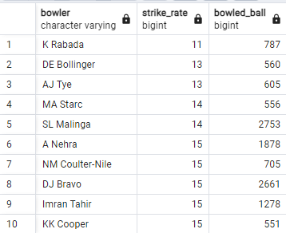
Bidding on BOWLERS
Bowlers with the best strike rate and have bowled at least 500 balls in IPL
SELECT bowler, COUNT(ball)/COUNT(CASE WHEN is_wicket=1 THEN 1 ELSE NULL END) AS strike_rate,COUNT(ball) AS bowled_ballFROM IPL_BallWHERE extras_type = 'NA'GROUP BY bowlerHAVING COUNT(ball)>=500ORDER BY strike_rate ASC LIMIT 10;

Slide 9

Bidding on BOWLERS
All rounders with the best batting strike and bowling strike rate as well, who have faced at least 500 balls In IPL and have bowled minimum 300 balls

Slide 10
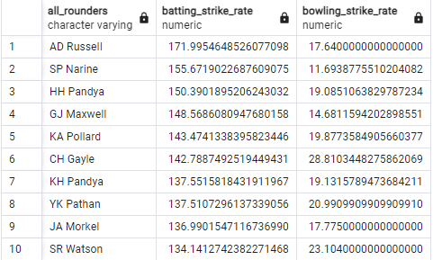
Query:
SELECT batsman AS all_rounders,SUM(batsman_runs) * 100.0 / COUNT(ball) AS batting_strike_rate, COUNT(ball) * 1.0 / COUNT(CASE WHEN is_wicket = 1 THEN 1 ELSE NULL END) AS bowling_strike_rateFROM IPL_BallWHERE batsman IN(SELECT bowler FROM IPL_Ball GROUP BY bowler HAVING COUNT(ball)>=300)GROUP BY batsman HAVING COUNT(ball)>=500ORDER BY batting_strike_rate DESC,bowling_strike_rate ASC LIMIT 10;
For wicketkeepers I believe they should be hard hitters as they play an important role in team’s overall success and should be all rounders.

Slide 11

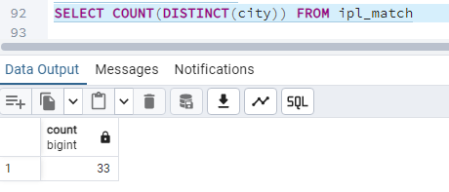
Queries
1. Get the count of cities that have hosted an IPL match
SELECT COUNT(DISTINCT(city)) FROM IPL_Match

Slide 12
queries
2. Create table deliveries_v02 with all the columns of the table ‘deliveries’ and an additional column ball_result containing values boundary, dot or other depending on the total_run (boundary for >= 4, dot for 0 and other for any other number)
CREATE TABLE deliveries_v02 ASSELECT *, (CASE WHEN total_runs>=4 THEN 'boundary’ WHEN total_runs = 0 THEN 'dot’ ELSE 'other' END) AS "ball_result“ FROM IPL_Ball

Slide 13
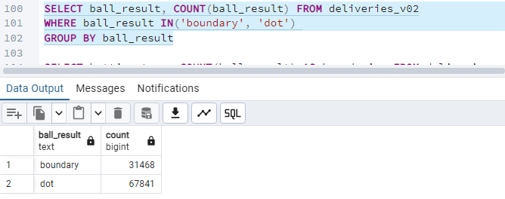

queries
3. Write a query to fetch the total number of boundaries and dot balls from the deliveries_v02 table.
SELECT ball_result, COUNT(ball_result) FROM deliveries_v02WHERE ball_result IN('boundary', 'dot') GROUP BY ball_result

Slide 14
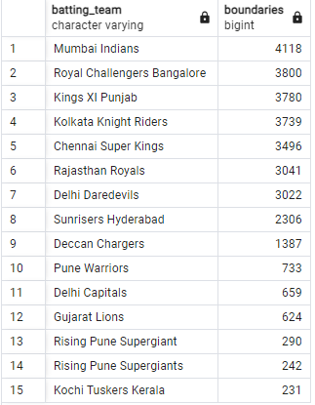
queries
4. Write a query to fetch the total number of boundaries scored by each team from the deliveries_v02 table and order it in descending order of the number of boundaries scored.
SELECT batting_team, COUNT(ball_result) AS boundaries FROM deliveries_v02WHERE ball_result = 'boundary'GROUP BY batting_teamORDER BY boundaries DESC;

Slide 15
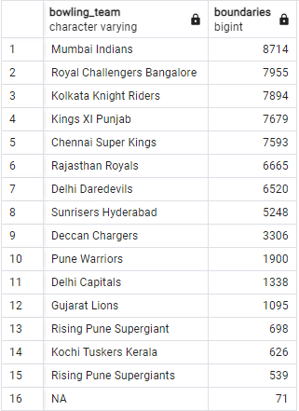
queries
5. Write a query to fetch the total number of dot balls bowled by each team and order it in descending order of the total number of dot balls bowled.
SELECT bowling_team, COUNT(ball_result) AS boundaries FROM deliveries_v02WHERE ball_result = 'dot'GROUP BY bowling_teamORDER BY boundaries DESC;

Slide 16
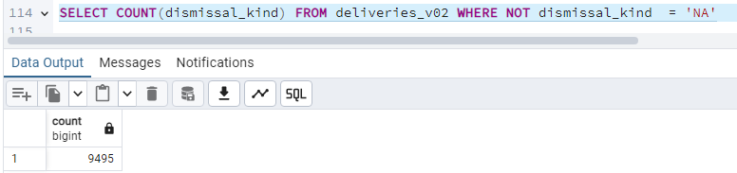
queries
6. Write a query to fetch the total number of dismissals by dismissal kinds where dismissal kind is not NA
SELECT COUNT(dismissal_kind) FROM deliveries_v02 WHERE NOT dismissal_kind = 'NA'

Slide 17
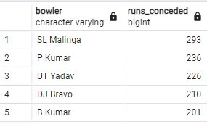
queries
7. Write a query to get the top 5 bowlers who conceded maximum extra runs from the deliveries table
SELECT bowler, SUM(extra_runs) AS runs_concededFROM IPL_BallGROUP BY bowlerORDER BY runs_conceded DESC LIMIT 5

Slide 18

queries
8. Write a query to create a table named deliveries_v03 with all the columns of deliveries_v02 table and two additional column (named venue and match_date) of venue and date from table matches
CREATE TABLE deliveries_v03 AS
SELECT d.*, im.venue AS venue, im.date AS match_date
FROM deliveries_v02 AS d LEFT JOIN IPL_Match AS im
ON d.id = im.id

Slide 19
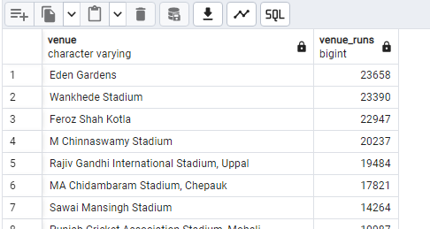
queries
9. Write a query to fetch the total runs scored for each venue and order it in the descending order of total runs scored.
SELECT venue, SUM(total_runs) AS venue_runs FROM deliveries_v03 GROUP BY venue ORDER BY venue_runs DESC

Slide 20
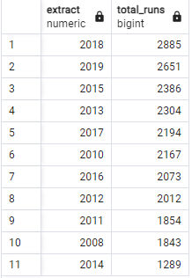
queries
10. Write a query to fetch the year-wise total runs scored at Eden Gardens and order it in the descending order of total runs scored.
SELECT EXTRACT(YEAR FROM match_date), SUM(total_runs) AS total_runs FROM deliveries_v03WHERE venue = 'Eden Gardens'GROUP BY EXTRACT(YEAR FROM match_date)ORDER BY total_runs DESC

Slide 21

THANK YOU

